Slide 1

FORMULA D1Y
Caroline, Forest, Vickie, Cindy

Slide 2

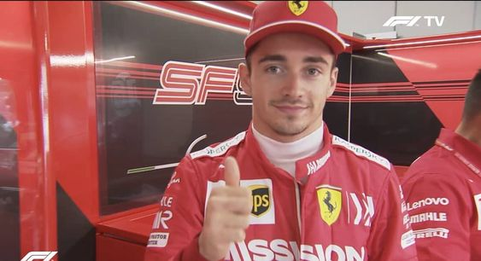
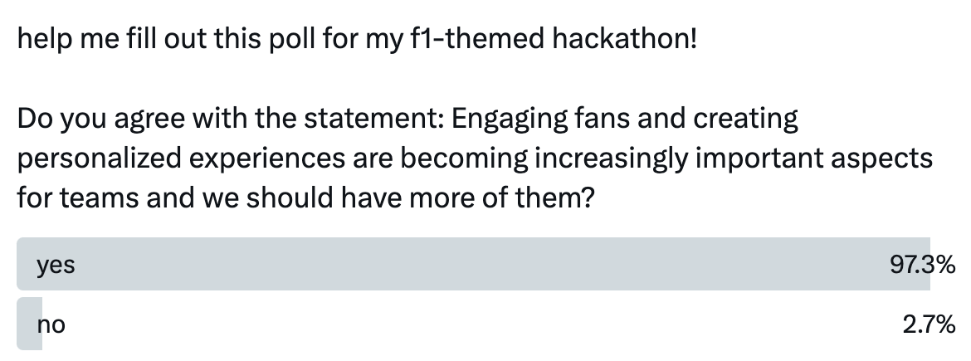
the PROBLEM
Enhancing Race Car Performance and Fan Engagement through Personalized Racing Experience
Overview:
F1 is all about performance - but what about the fans?
Engaging fans and creating personalized experiences are becoming increasingly important aspects for teams (as a stan myself)
We aim to address this by leveraging data science and personality insights to customize race car designs and enhance fan engagement

Slide 3
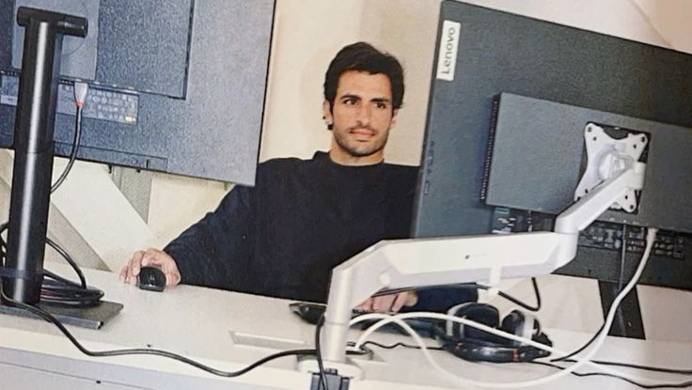
Tech Stack Details - Python, R, HTML/CSS
Data Analysis
Personality Quiz
Customized Race Car
By using R to analyze a dataset of 868 Formula 1 drivers, we wrangle the data to get top 10 race starters, top 10 drivers by pole positions, top 10 drivers with most wins, drivers’ nationalities, and trend of number of drivers over the decades.
By using Javascript and HTML, users can take a personality test to figure out their MBTI, and will be shown a list of drivers with the same personality types.
We developed a solution using HTML and Python with different buttons to create a customized race car, including different wheel colors, body colors, and different drivers.
us ❤️

Slide 4
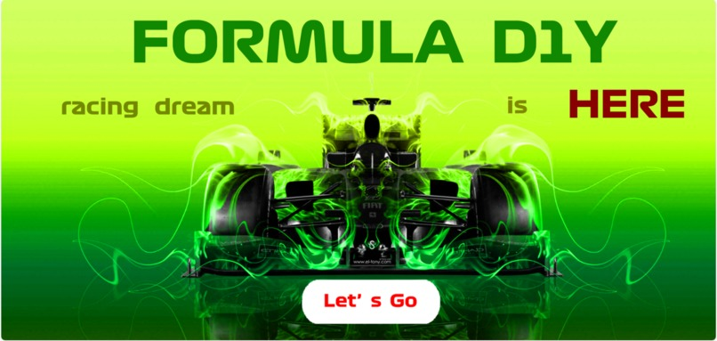

Slide 5
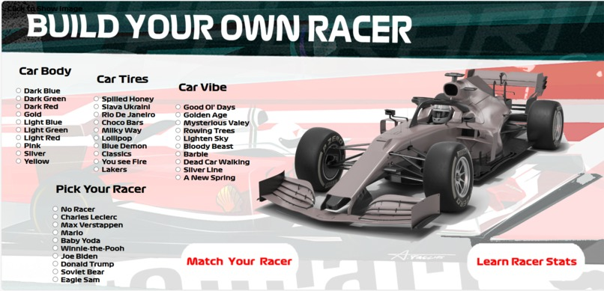

Slide 6
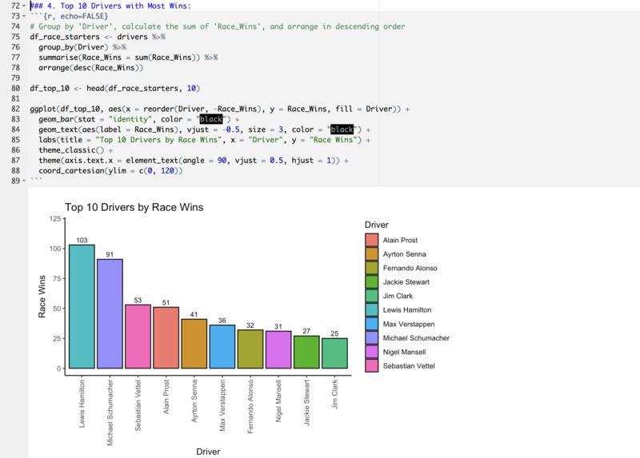

Slide 7
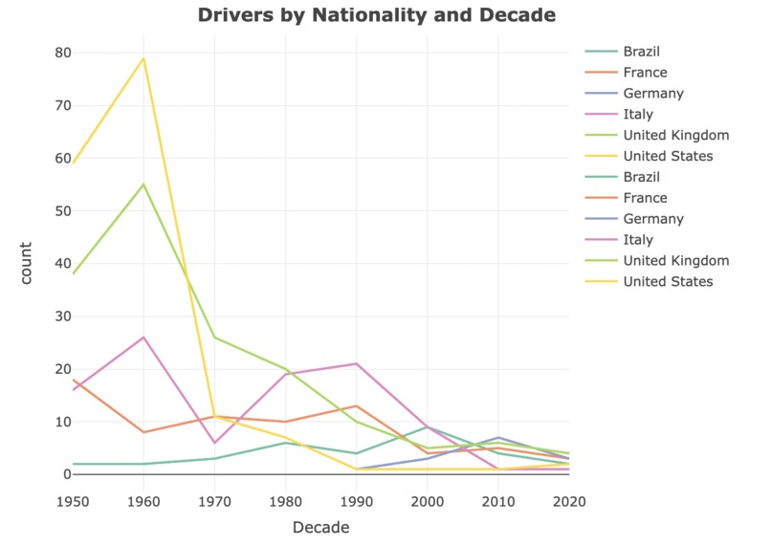

Slide 8
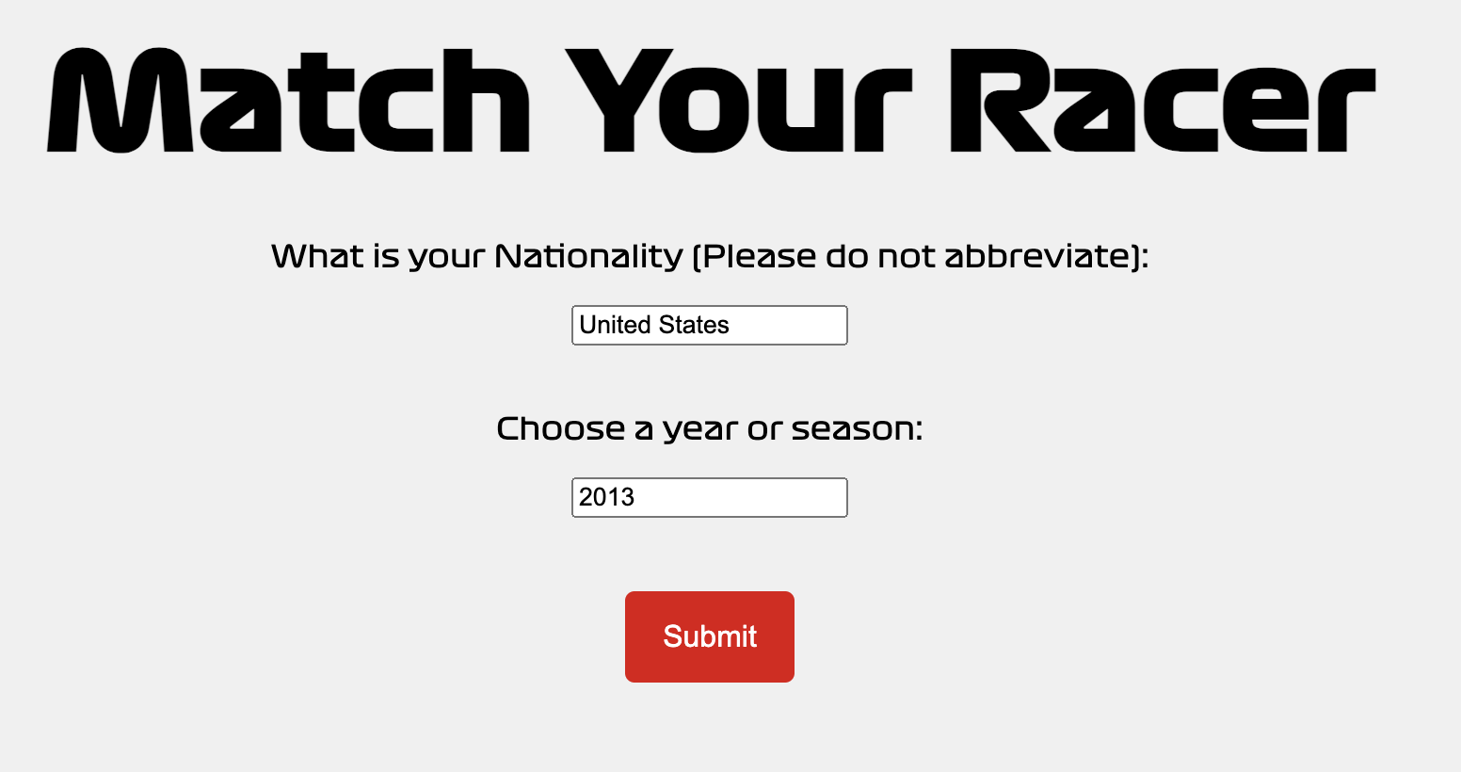

Slide 9


Slide 10
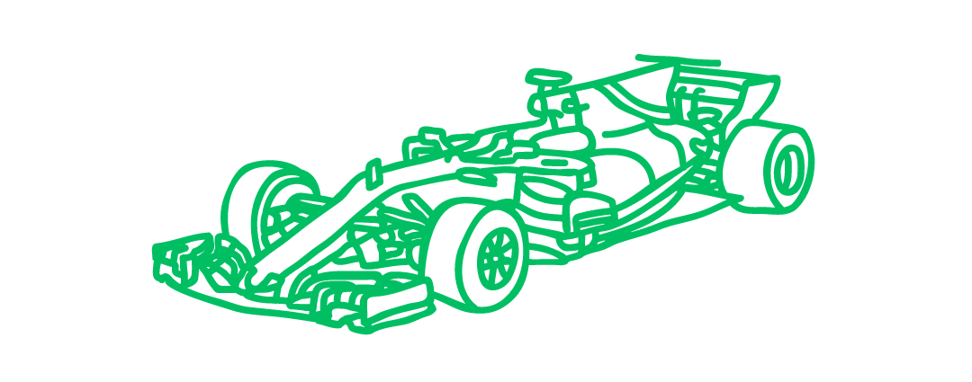
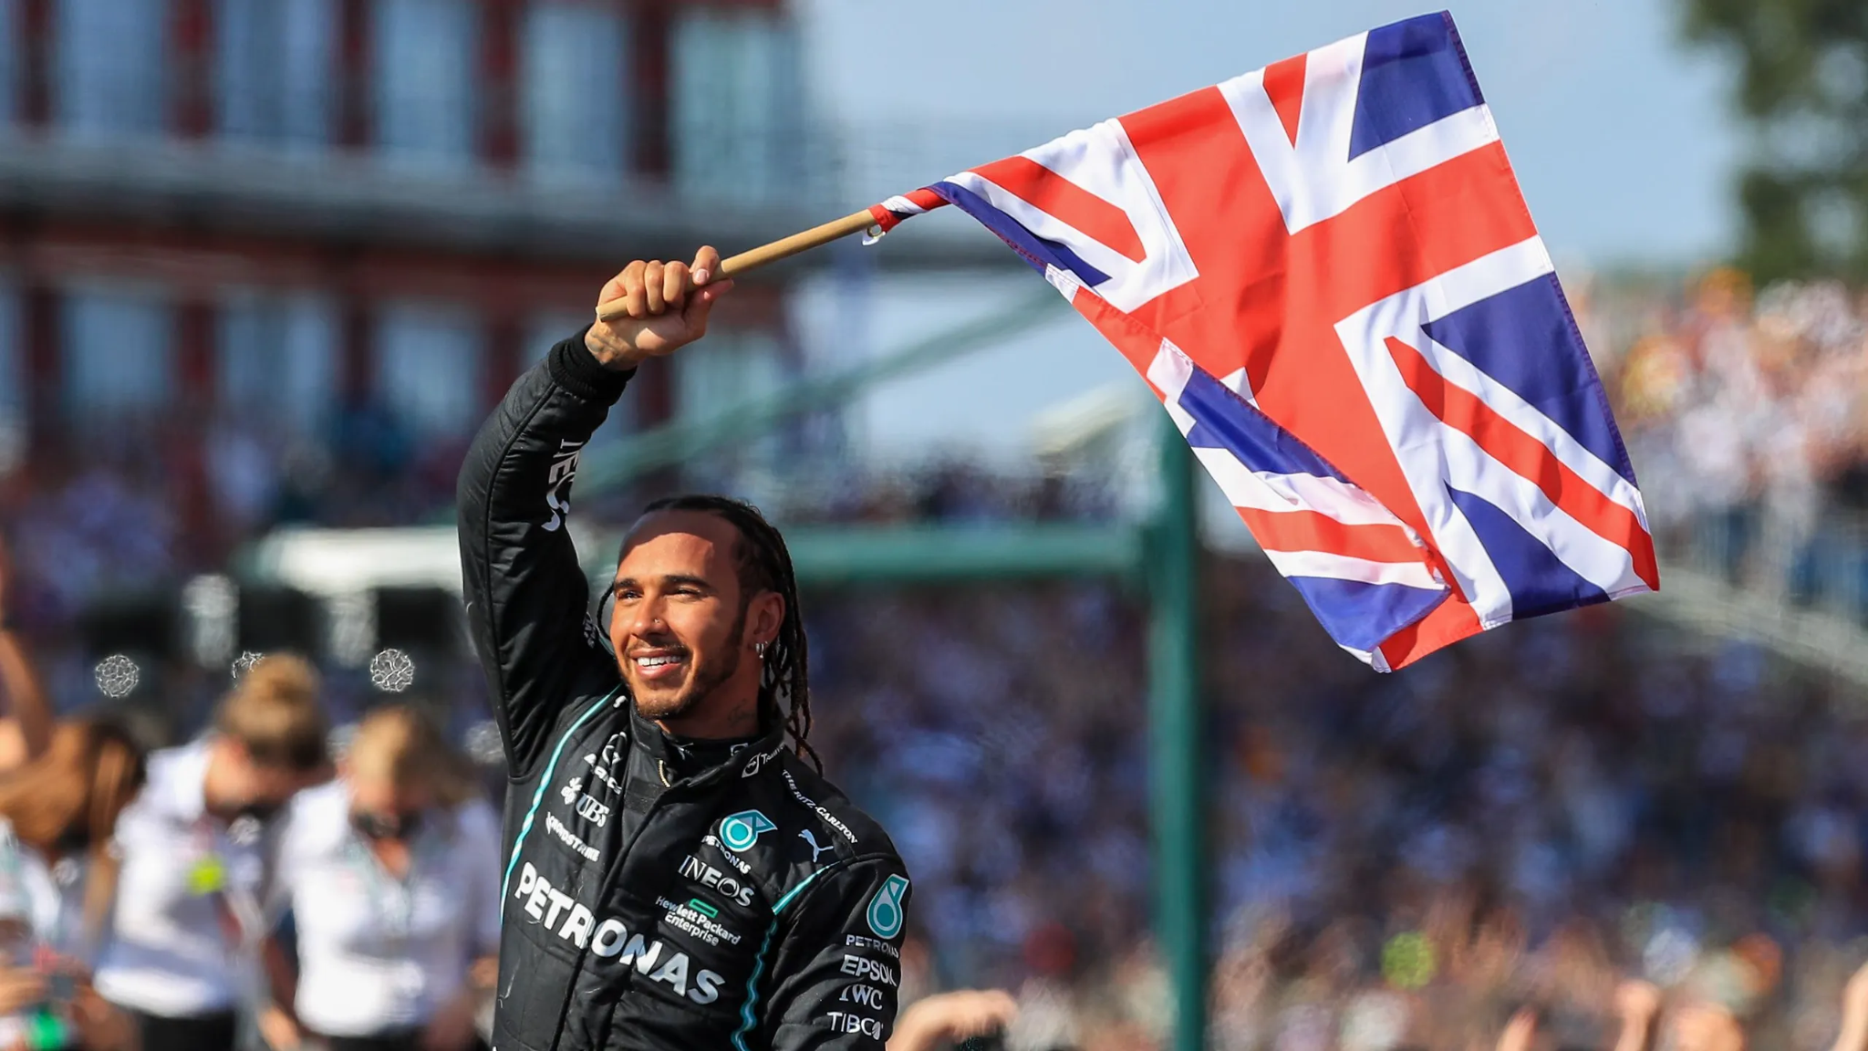
What We Learned - Data Analysis
From 1950 to 2023, drivers from US, UK, France, Italy decreased overall, and drivers from Germany and Brazil slightly increased
Lewis Hamilton has the most Pole Positions and most Race Wins (GOAT :D)
Out of 868 F1 drivers, the most common nationalities are the United Kingdom, United States, and Italy

Slide 11

Future Applications
Creating an application
Branch out to other levels of motorsport (include different cars to customize, including IndyCar and NASCAR and WEC)
Create data analyses on lower level Formula 2 drivers and likelihood of making it to Formula 1
Branch out to using testing other personality types besides Myers-Briggs test, such as the Enneagram test or the Big Five

